Slide 1
Real Time Object Detection and Counting
Prepared by : Virag Patel
ID : 19IT114

Slide 2
What is OPEN-CV?
OpenCV (Open Source Computer Vision Library) is an open source computer vision and machine learning software library.
Built to provide a common infrastructure for computer vision applications and to accelerate the use of machine perception in the commercial products.
More than 2500 optimized algorithms
These algorithms can be used to detect and recognize faces, identify objects, classify human actions in videos, track camera movements, track moving objects, extract 3D models of objects, produce 3D point clouds from stereo cameras, stitch images together to produce a high resolution image of an entire scene, etc.

Slide 3

Training the model.
HAAR- Cascade Classifier
BackgroundSubtractorMOG2 algorithm

Slide 4
Detection using HAAR-Cascade

Slide 5
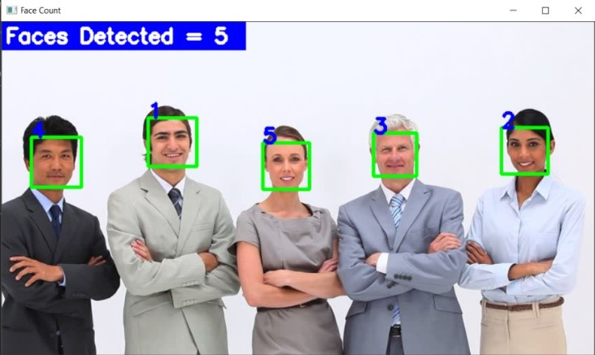
Face-Detection
Using Pre trained Haar-Cascade classifier

Slide 6
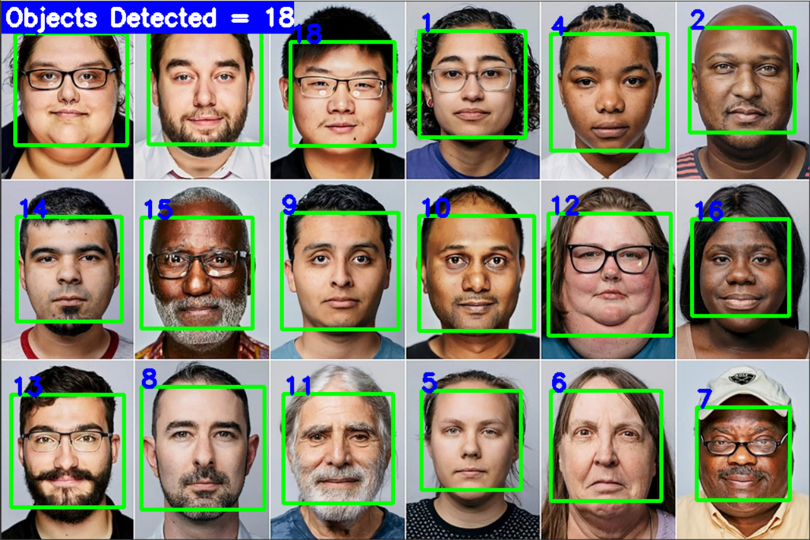
Face-Detection
Using Pre trained Haar-Cascade classifier

Slide 7
Drawbacks of HAAR-features based classifier
Separate Classifier.
Lots of Data (Positives and Negatives)
Time Consuming

Slide 8

Big concept
Detection using BackgroundSubtractorMOG2 algorithm

Slide 9
BackgroundSubtractorMOG2
It is a Gaussian Mixture-based Background/Foreground Segmentation Algorithm. It provides better adaptability to varying scenes due illumination changes etc.

Slide 10
Main Steps
Object Detection
Object detection is the detection on every single frame and frame after frame..
Object Tracking
Object tracking does frame-by-frame tracking but keeps the history of where the object is at a time after time
Marking Object on the video Frame
A 2-D shape is drawn around the Detected Object

Slide 11
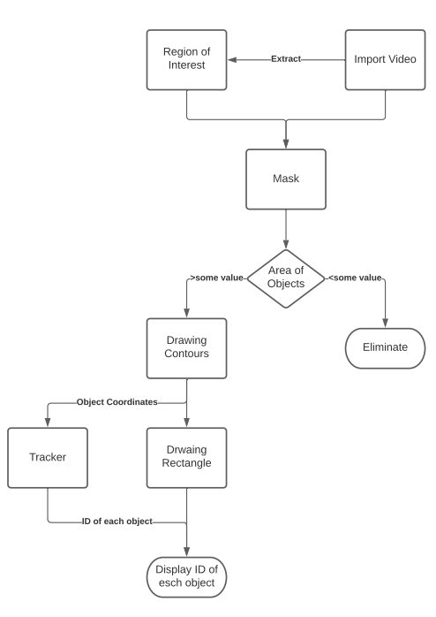
Flow-Chart of the Algorithm

Slide 12

OUTPUT

Slide 13
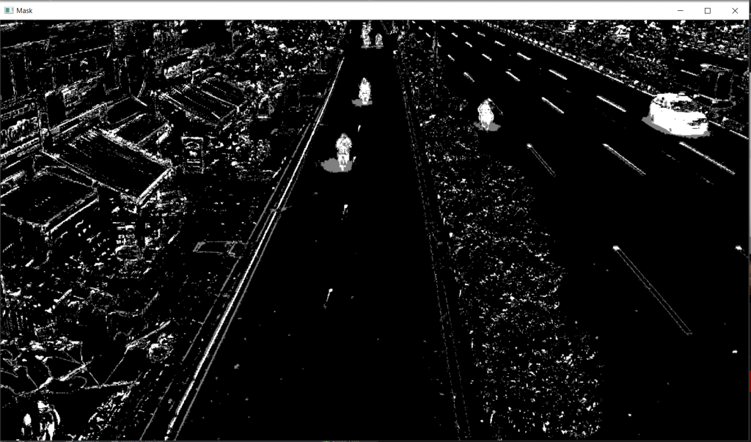
Applying Mask

Slide 14
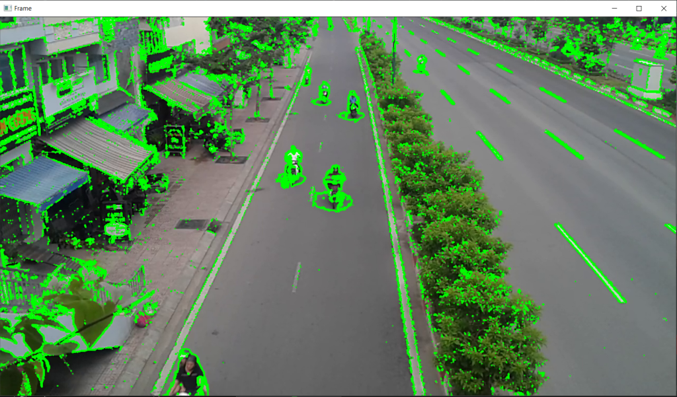
Drawing Contours around the necessary Objects

Slide 15
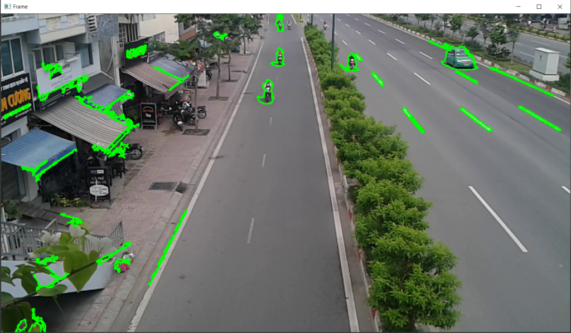
Drawing Contours around the Objects with a large area (removing Noise).

Slide 16
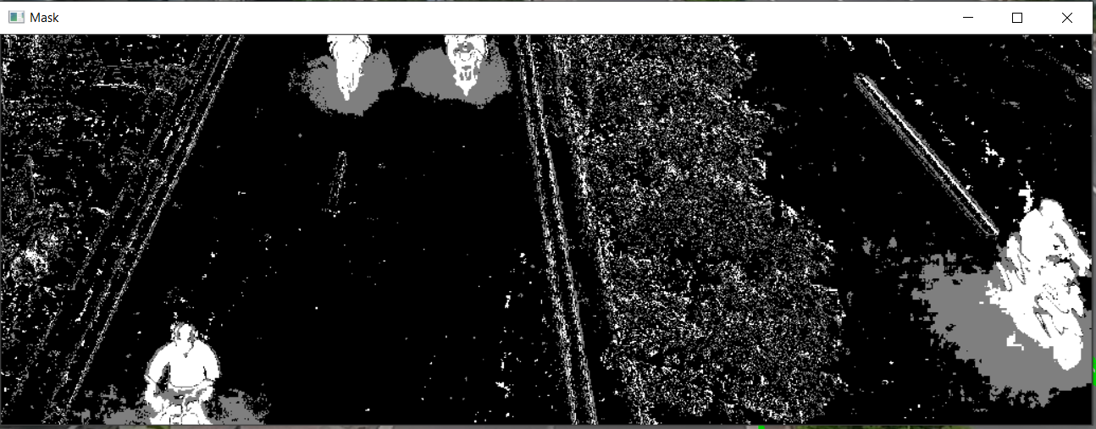
Extracting Region of Interest (ROI) and applying mask on it.

Slide 17
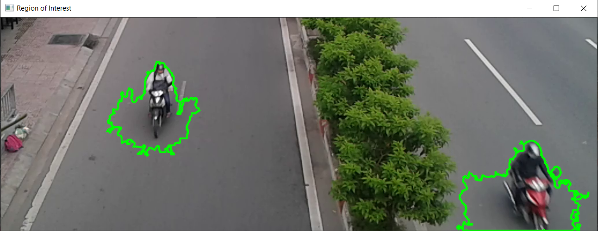
Drawing Contours around the necessary Objects

Slide 18
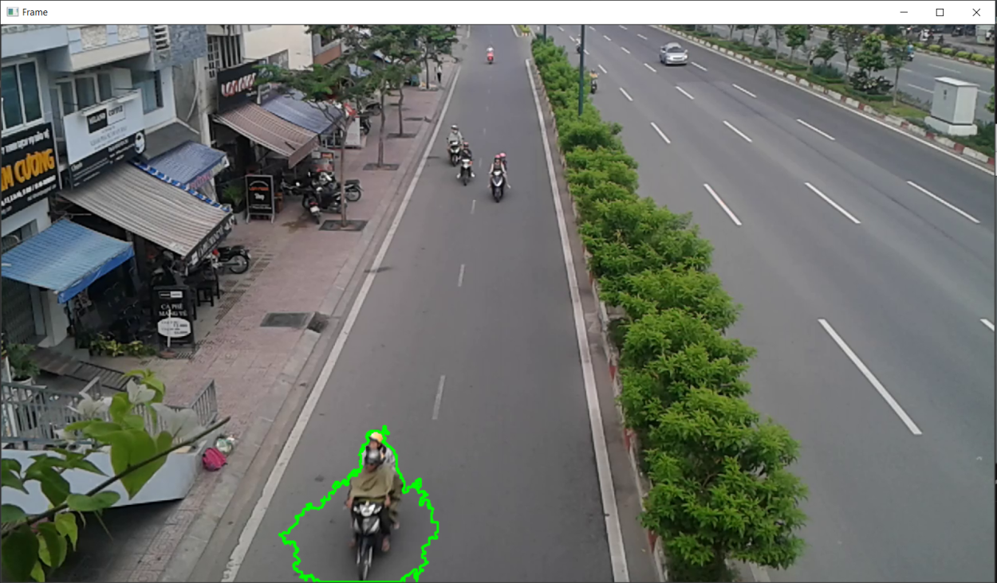
Restricting the detection in ROI in actual Video frame.

Slide 19
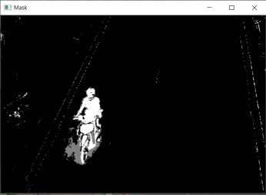
Detection includes the shadow of the Object.

Slide 20
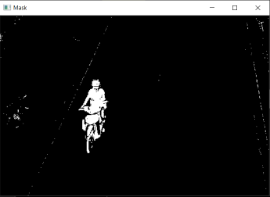
Detection does not includes the shadow of the Object.

Slide 21
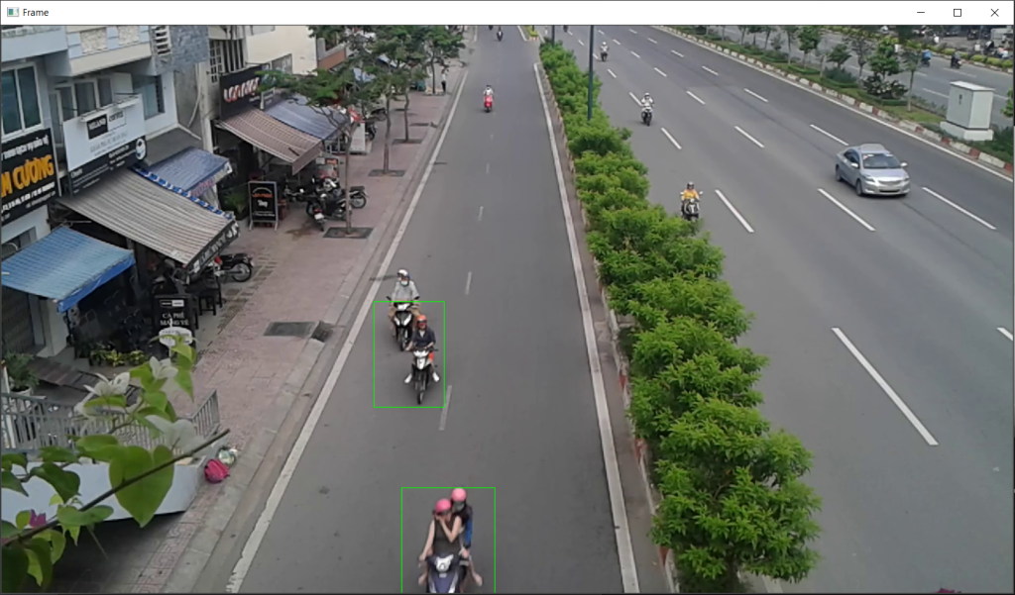
Drawing a rectangle around the detected objects.

Slide 22
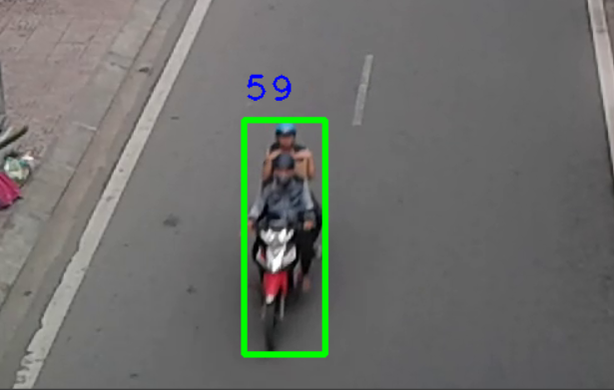
Numbering the objects.

Slide 23
Analysis of the Algorithm

Slide 24
SWOT Analysis
STRENGTHS
It could detect every object passing from ROI
WEAKNESSES
It misinterpets the same object with changing pixel itensity.
S
W
Most of the time it is very useful to separate out the background in order to concentrate on the foreground. OPPORTUNITIES
Requires a video from a stable camera.
THREATS
O
T

Slide 25
Conclusion
Experiments have been performed and it is found that this particular algorithm achieves the detection of objects more precisely for simple scenarios. For better detection more precise algorithms needs to be used. From this project, it can be inferred that the accuracy provided by this algorithm is nearly 75

Slide 26
Thank You..!
Any questions?

